Slide 1
Final Presentation Digital Pre-Distortion
Students: Adir Cohen Nissan
Supervisor: [Supervisor Name]
Semester: Spring, 2022
Date: [dd/mm/yy]
In collaboration with: [company name/logo]

Slide 2
Outline
This slide should contain an outline (list of headings) of the presentation
Maximum 5-6 bullets

Slide 3
Project Goal
Power amplifiers (PAs), are inherently nonlinear systems.
nonlinearity causes in-band distortion and a spectral regrowth.
The role of the Digital Pre Distortion (DPD) is to distort the signal in a way that will be, in turn, compensated by the PA. .

Slide 4
Project Goal
The aim of this project is that ideally, the total response of the Pre-distorter and PAs will be linear (reduce am/am, am/pm distortions and OOB emission) up to some saturation voltage.
Using both classical and deep learning methods, we will create a digital pre distorter that preprocess a signal before entering a nonlinear power amplifier.

Slide 5
Background
Different transmission formats, such as wideband Code Division Multiple Access (CDMA) or Orthogonal Frequency Division Multiplexing (OFDM), are known to have high peak to average power ratios.
That increases the risk of using voltages that are close to the PAs saturation point, as this will lead to a severe distortion, as mentioned above.
For this reason, PA linearization methods have gained popularity and increasing interest in recent years.

Slide 6
Literature Survey
Describe existing solutions to the problem that you have found in the literature survey
For each solution, give a general overview, some details, pros and cons (quality, complexity, cost, …)

Slide 7
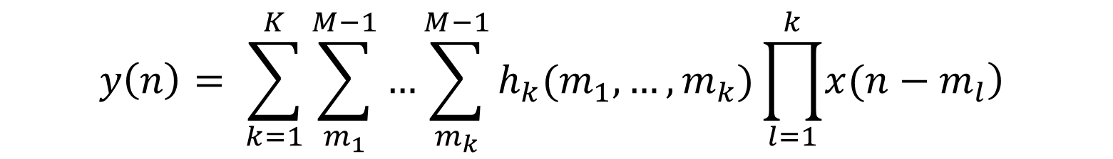
Volterra series as a PA model
In addition to being nonlinear systems, PAs also exhibit memory effects.
Volterra series are used in order to model systems that are both nonlinear and have memory.
$$y\left(n\right)= \sum_{k=1}^{K}{\sum_{m_{1}}^{M−1}{…}\sum_{m_{k}}^{M−1}{h_{k}(m_{1},…,m_{k})\prod_{l=1}^{k}{\left.x(n−m_{l}\right)}}}$$

Slide 8
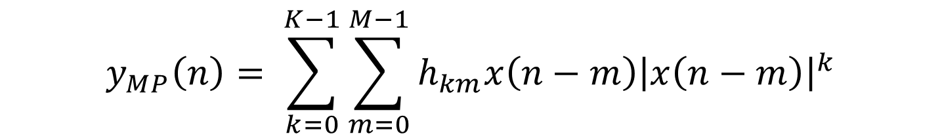
Memory polynomial
Memory Polynomial model is a simplification of the full Volterra model, with less coefficients
$$y_{MP}\left(n\right)= \sum_{k=0}^{K−1}{\sum_{m=0}^{M−1}{h_{km}x\left(n−m\right){\left|x\left(n−m\right)\right|}^{k}}}$$

Slide 9
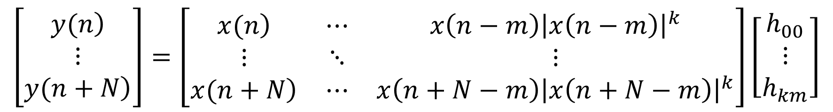

Matrix form
This model can be represented efficiently in matrix form as:
$$y=Xθ_{MP}$$
$$\left[\begin{matrix}\left.y(n\right) \\ ⋮ \\ \left.y(n+N\right)\end{matrix}\right]=\left[\begin{matrix}\left.x(n\right) & ⋯ & x\left(n−m\right){\left|x\left(n−m\right)\right|}^{k} \\ ⋮ & ⋱ & ⋮ \\ \left.x(n+N\right) & ⋯ & x\left(n+N−m\right){\left|x\left(n+N−m\right)\right|}^{k}\end{matrix}\right]\left[\begin{matrix}h_{00} \\ ⋮ \\ h_{km}\end{matrix}\right]$$

Slide 10

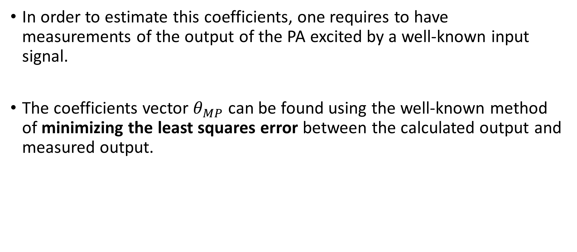
MSE
In order to estimate this coefficients, one requires to have measurements of the output of the PA excited by a well-known input signal.
The coefficients vector $θ_{MP}$ can be found using the well-known method of minimizing the least squares error between the calculated output and measured output.
$$θ_{MP}={\left(X^{H}X\right)}^{−1} Xy$$

Slide 11

MSE
Another way to find the parameters that minimize the least squares error is using SGD.
**Normalized
$$μ=α⋅{\left(X^{H}X+εI\right)}^{−1}$$
$$θ^{\left(n+1\right)}=θ^{\left(n\right)}−2μX^{H}\left(Xθ^{\left(n\right)}−y\right)$$

Slide 12
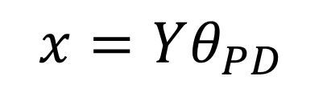
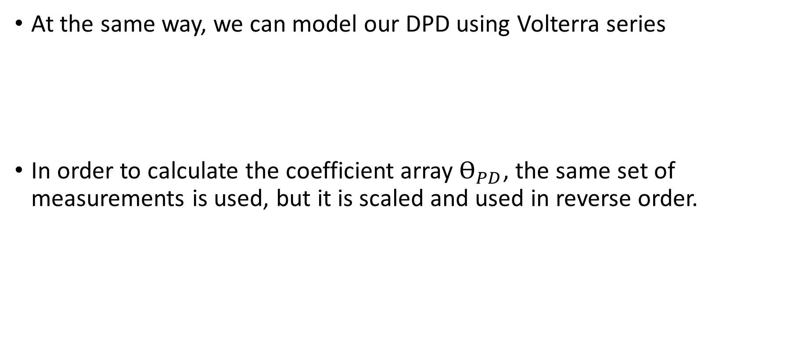
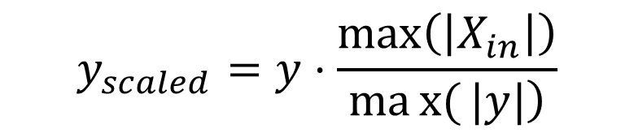
Volterra series as a DPD
At the same way, we can model our DPD using Volterra series
In order to calculate the coefficient array $Ѳ_{PD}$, the same set of measurements is used, but it is scaled and used in reverse order.
$$x=Yθ_{PD}$$
$$y_{scaled}=y⋅\frac{\max\left(\left|X_{in}\right|\right)}{\left.max{(}|y|\right)}$$

Slide 13
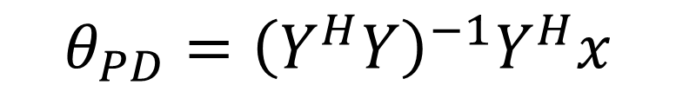

MSE
The coefficients vector $θ_{MP}$ can be found using the same algorithm as used at the pa modeling.
$$θ_{PD}={\left(Y^{H}Y\right)}^{−1}Y^{H}x$$

Slide 14
פה להציג פתרונות לא קלאסיים

Slide 15
Chosen Solution – זה הdeep שנבחר להציג
Emphasize the key idea
If the audience remembers only one thing from your talk, what should it be?
Then, give a more detailed explanation of the chosen solution
You usually start with a block diagram slide followed by a few more slides describing each block in the diagram in detail
Prefer deep details (technical ‘meat’) of part of the solution over a shallow overview of many topics

Slide 16
Results
Present your results compared to other solutions and emphasize the advantages (and disadvantages) of your solution
Give examples
Illustrate the idea in action
Show extreme cases

Slide 17
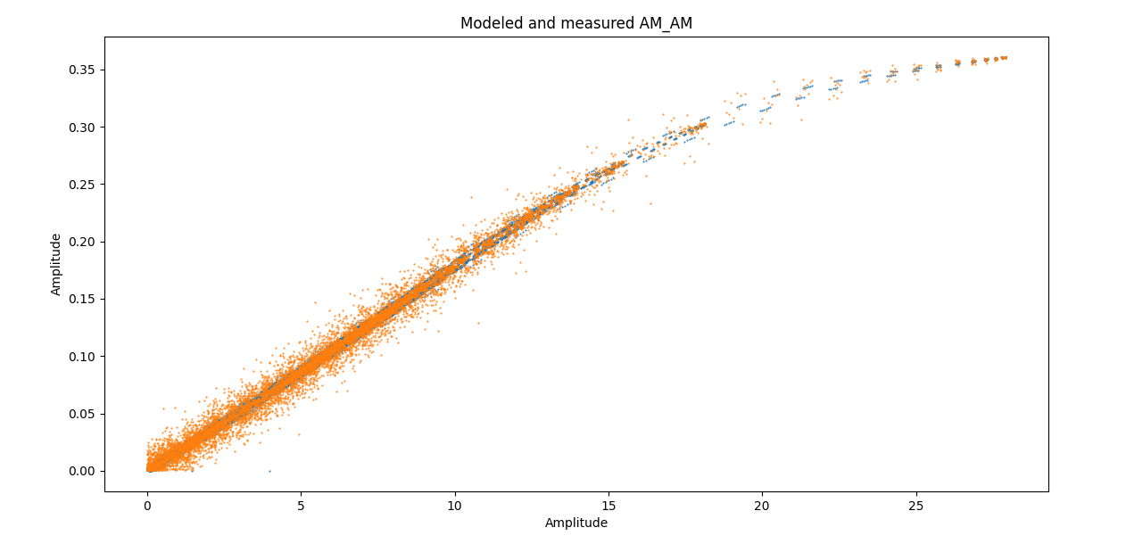
Classical - PA modeling
illustration of AM/AM distortion of input signal, caused by modeled PA, and real lab’s PA

Slide 18
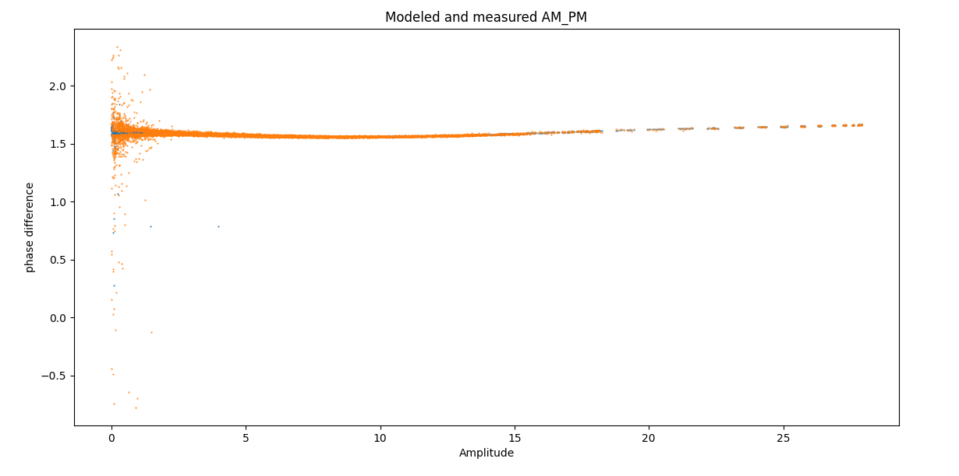
Classical - PA modeling
illustration of AM/PM distortion of input signal, caused by modeled PA, and real lab’s PA

Slide 19
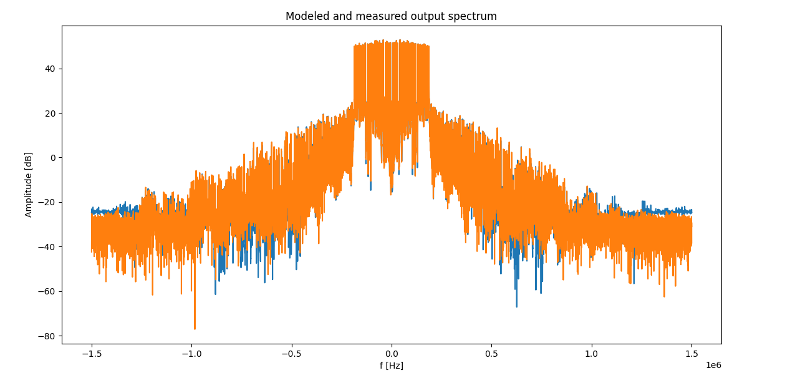
Classical - PA modeling
illustration of OOB emission caused by modeled PA, and real lab’s PA

Slide 20
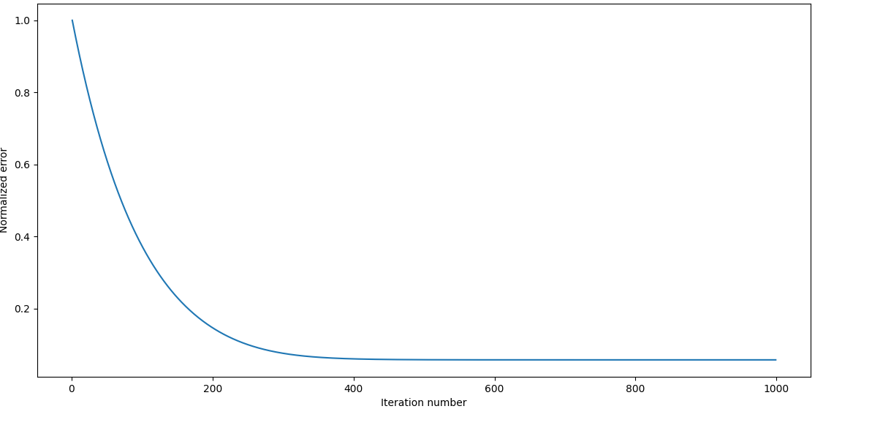
SGD
Normalized error between SGD modeled PA output and real Lab’s PA output

Slide 21
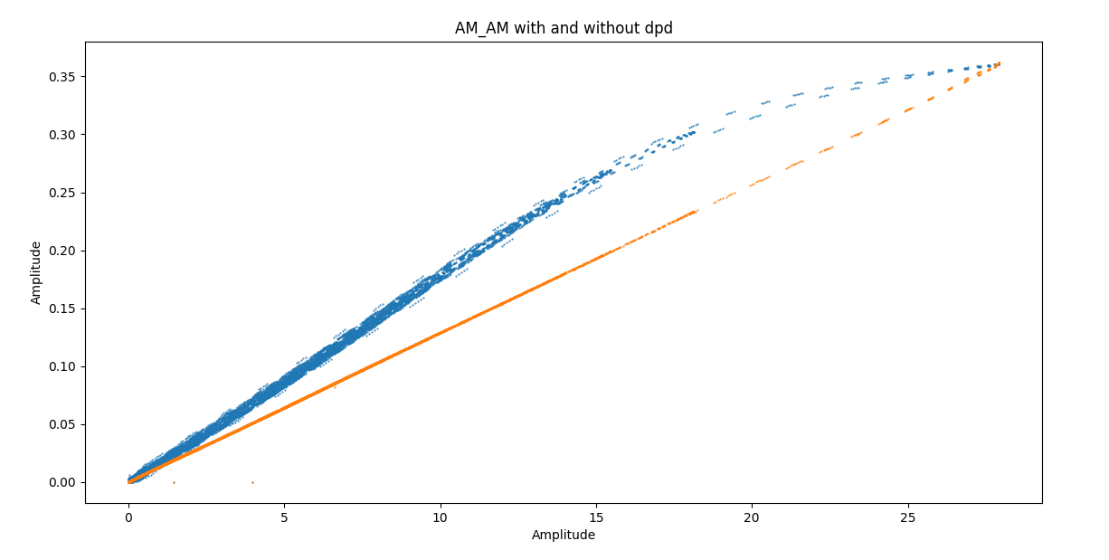
Classical - DPD
illustration of AM/AM distortion of input signal, with and without classical DPD

Slide 22
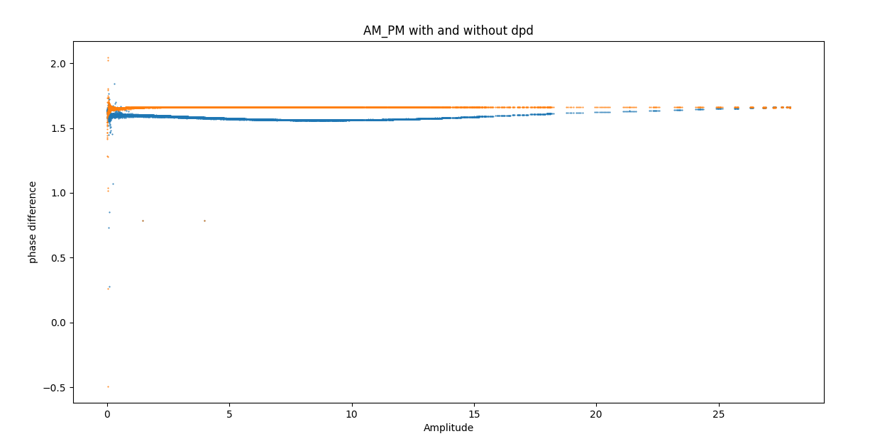
Classical - DPD
illustration of AM/PM distortion of input signal, with and without classical DPD

Slide 23
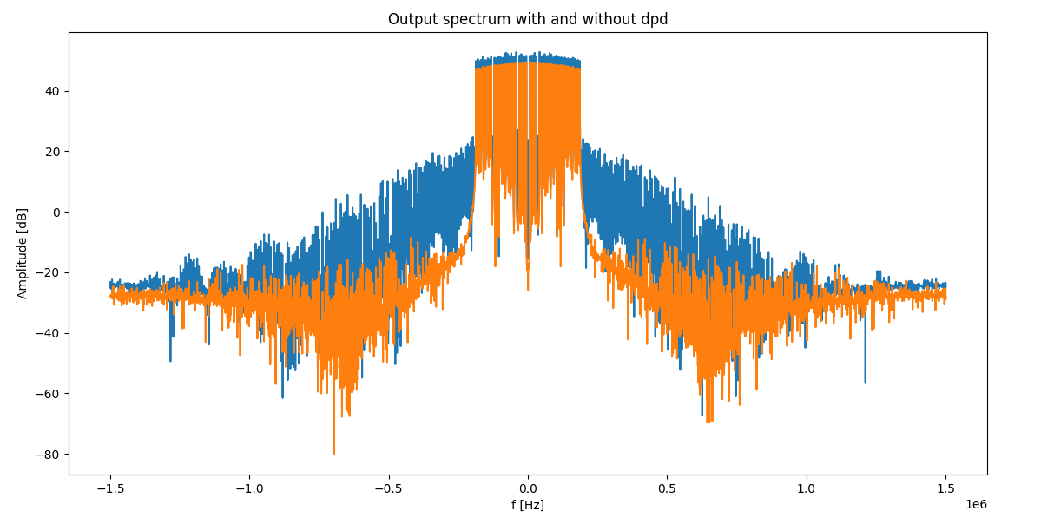
Classical - DPD
illustration of OOB emission caused by modeled PA, with and without classical DPD

Slide 24
NN - PA modeling

Slide 25
NN - DPD

Slide 26
Conclusion
Repeat the project goal in other words
Have you achieved the goal? (if not, that’s fine and you have to explain why)
Summarize your results
Emphasize original contribution

Slide 27
References
Only the most important references should be mentioned here, in IEEE format
Here are some examples:
Yariv Ephraim and David Malah. "Speech enhancement using a minimum-mean square error short-time spectral amplitude estimator." IEEE Transactions on Acoustics, Speech, and Signal Processing 32.6 (1984): 1109-1121.
Oded Schlesinger, et al. "Blood Pressure Estimation from PPG Signals Using Convolutional Neural Networks and Siamese Network." IEEE International Conference on Acoustics, Speech and Signal Processing (ICASSP), 2020.

